Slide 1


NEXT GEN EMPLOYABILITY PROGRAM
CREATING A FUTURE-READY WORKFORCE
Student Name :
UNNATI NIGAM
Student ID :
College Name :
STU61ffd52a92fd41644156202
KIET Group of Institutions

Slide 2
CAPSTONE PROJECT SHOWCASE
Project Title
Customer Segmentation Model using Python
Abstract | Problem Statement | Project Overview | Proposed Solution | Technology Used | Modelling & Results | Conclusion | Q&A

Slide 3
Abstract
Customer segmentation is a fundamental aspect of marketing strategy, aiming to divide a heterogeneous customer base into more manageable and targeted groups.
1
The model incorporates various data sources, including transactional data, demographic information, and customer interactions.
2
Using the prepared data, we generate visual representations and extract key insights and metrics essential for gaining a clearer understanding of customer behavior and trends.
3
Afterward, we visualized the data, examining missing values and their interrelationships from multiple perspectives, prior to implementing the clustering model. Subsequently, we proceeded to construct a recommendation system based on these insights.
4

Slide 4


Problem Statement
developing a clear understanding of their customer base's distinct preferences, behaviors, and needs, businesses struggle to tailor their marketing strategies and offerings appropriately.

Slide 5

Project Overview
Develop a robust customer segmentation model: Utilize advanced machine learning and data analytics techniques to accurately categorize customers into meaningful segments based on demographic, transactional, and behavioral attributes.

Slide 6
Proposed Solution
Data Collection and Preprocessing:
Retrieve pertinent data from the dataset and eliminate any missing values through data cleaning procedures.
Feature Engineering:
Utilize the refined dataset to generate additional valuable insights about the customers.
Scaling and Dimensionality Reduction:
Condense the dataset within a specified scope to expedite and optimize training processes.

Slide 7
Technology used
Numpy
Pandas
MatplotLib
SKLearn (SciKit Learn)
Seaborn
Clustering

Slide 8
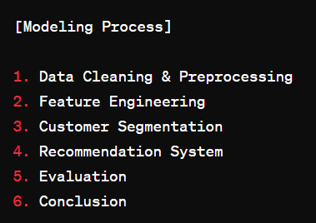
Modelling
In the modelling phase, we meticulously cleaned and pre-processed the transactional dataset sourced from a UK-based retailer. Leveraging Python's Pandas library, we addressed missing values, duplicates, and outliers to ensure data integrity. Following this, we embarked on feature engineering, where we crafted customer-centric attributes such as purchase frequency, total spending, and product category preferences. These features were designed to capture the nuances of customer behaviour, laying a solid foundation for subsequent analysis.

Slide 9
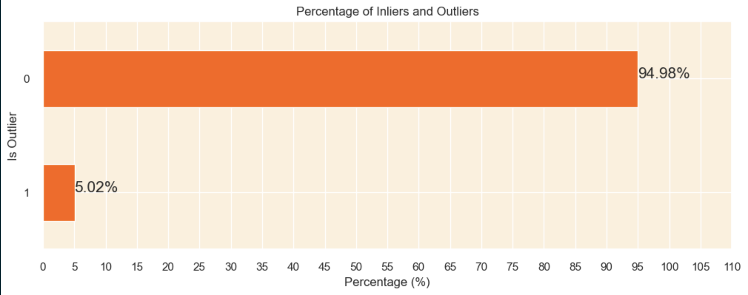
Modelling & Result

Slide 10
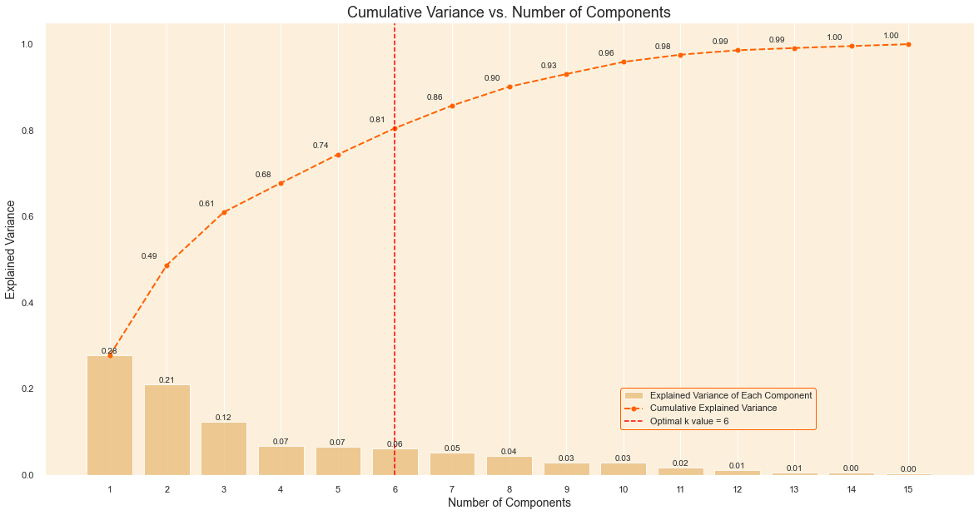
Modelling & Result

Slide 11
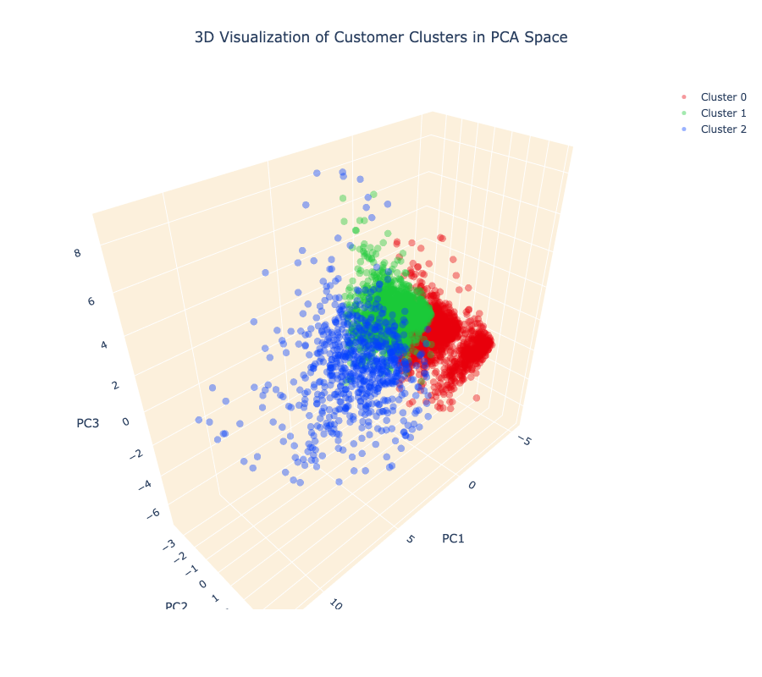
Modelling & Result

Slide 12

Conclusion
Customer data has been categorized, facilitating product recommendations aligned with their interests, thereby optimizing resource utilization and consumption.

Slide 13


Notes:
Thank You !!

